Slide 1
The Future Of The Web
Name: Musaib Khan Roll No: CNC005152
Batch: WMD-38

Slide 2
What Is Cloud Computing?
Cloud computing is the delivery of different services through the Internet. These resources include tools and applications like data storage, servers, databases, networking, and software. Cloud computing is a popular option for people and businesses for a number of reasons including cost savings, increased productivity, speed and efficiency, performance, and security

Slide 3
Cloud computing is the delivery of different services through the Internet, including data storage, servers, databases, networking, and software.
Cloud storage has grown increasingly popular among individuals who need larger storage space and for businesses seeking an efficient off-site data backup solution.
Cloud-based storage makes it possible to save files to a remote database and retrieve them on demand.
Services can be both public and private—public services are provided online for a fee while private services are hosted on a network to specific clients.

Slide 4
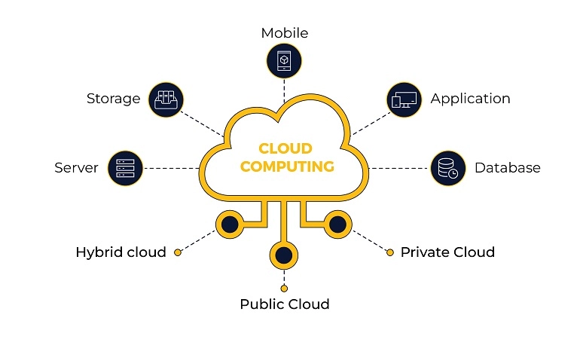

Slide 5
Edge Computing
Edge computing is a distributed open-stage computing framework near the things or information sources at the system edge. It coordinates the abilities of systems, networks, and applications. By conveying edge-intelligent administrations, edge computing meets the critical prerequisites of industry digitalization for lithe networks, real-time applications, information streamlining, application insight, security, and protection insurance. The practice of processing data near the edge of your network, where the data is being generated, instead of in a centralized data-processing warehouse.”

Slide 6
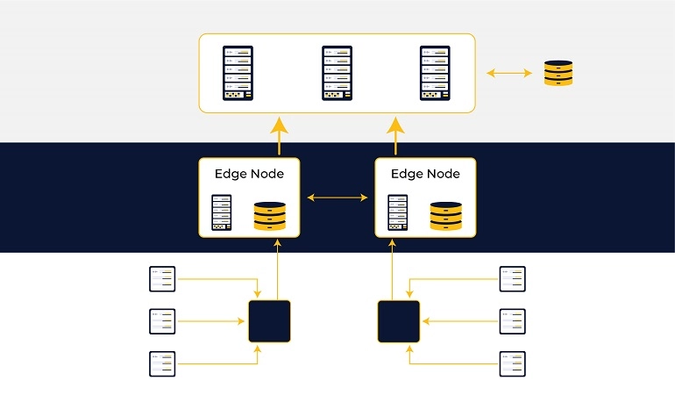

Slide 7
Advantages of Edge Computing
The primary benefit of edge computing is that it mitigates the risk of network breakdowns or cloud slowdowns when timely access to data is critical. Edge computing achieves this by embedding automation and intelligence into your physical devices.

Slide 8
Unprecedented Data Control:
Edge computing gives you massive control over data as it is the first point where computing accesses data. You can determine which data you want to keep and which ones you want to route, summarize, or obfuscate. You can also add controls at this point to manage data privacy, reliability, and security.
Take the example of facial recognition technology in smartphones. It uses edge computing, meaning that your face’s image is retained on your phone by AI. This ensures your privacy and security are not compromised, which is possible when you move the same to the cloud.
Reduced Latency:
Edge computing has low latency due to shorter network uptime, bandwidth limitations, and round-trip times.
Lower Costs:
Processing your data at the edge makes your cloud upload and storage a lot cheaper. You don’t need full-fidelity data when you can make do with a summary or key insights.

Slide 9
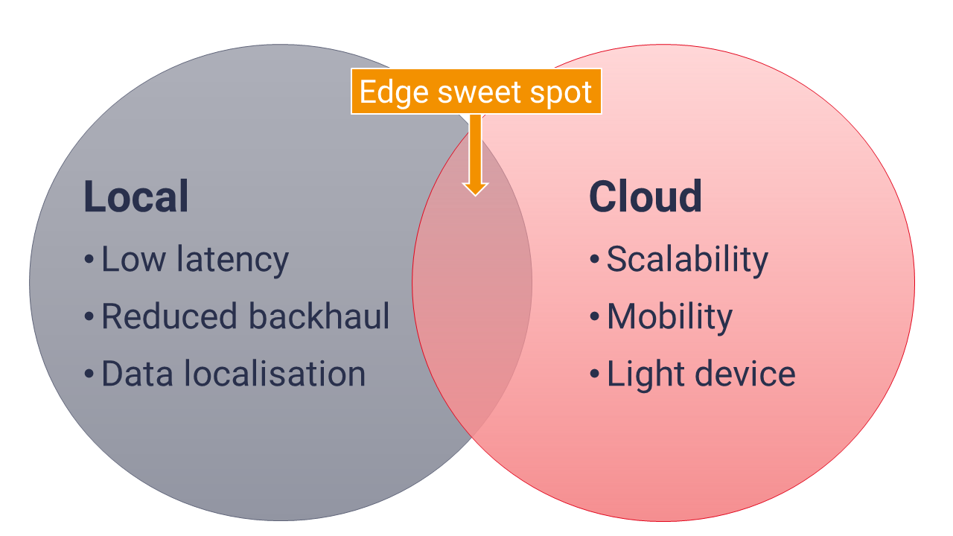
Why edge computing?
The following diagram demonstrates where the sweet spot is for edge computing. Since edge computing is likely to be more expensive than the centralised cloud, only those use cases that have requirements that fit into both the local and cloud computing sphere are likely to justify the investment. Some of these use cases exist today (such as improving customer experience when playing a game hosted in the cloud) and others don’t yet really exist (such as drone delivery of our online purchases).

Slide 10
Difference Between Edge and Cloud Computing
The primary difference between the two is that while edge computing moves computing to the edge of the network and as close to data sources as possible, cloud computing generates and collects data from multiple locations and stores it in the cloud. Cloud computing is, by its very nature, a centralized process. This is what enables it to process data at scale very easily and efficiently, costing you a lot less.
Most companies store and process their data on the cloud since it has almost unlimited resources compared to the small and resource-constrained devices onsite. Storage and computing have been expanding at a much faster rate than the capacity of the network. No matter the size or volume of the data, cloud computing can handle it once it moves to the cloud.

Slide 11
Does edge need 5G?
There is significant overlap in the use cases for both, such as AR and VR, autonomous cars, industry 4.0, IoT etc. Although edge computing supports these low latency applications, 5G enhances it by improving throughput and reducing latency.
In some cases, we need both to achieve latency that’s below 10 milliseconds. But there are still challenges for 5G as telcos will deploy gradually at first and focus on major cities. For this reason it could undermine adoption of applications such as enterprise AR. Telcos can combine edge compute with 4G to create workarounds in areas where 5G is yet to be rolled out.

Slide 12
Why People shift From Cloud To Edge?
For many companies, cost savings alone can be a driver to deploy edge-computing. Companies that initially embraced the cloud for many of their applications may have discovered that the costs in bandwidth were higher than expected, and are looking to find a less expensive alternative. Edge computing might be a fit.
Increasingly, though, the biggest benefit of edge computing is the ability to process and store data faster, enabling more efficient real-time applications that are critical to companies. Before edge computing, a smartphone scanning a person’s face for facial recognition would need to run the facial recognition algorithm through a cloud-based service, which would take a lot of time to process. With an edge computing model, the algorithm could run locally on an edge server or gateway, or even on the smartphone itself.
Applications such as virtual and augmented reality, self-driving cars, smart cities and even building-automation systems require this level of fast processing and response.

Slide 13
Edge computing and IoT
Edge computing brings data processing as close to an Internet of Things (IoT) device as possible. That can mean latency, performance, cost, and security advantages for enterprise IT.
Edge computing goes hand-in-hand with several other prominent technologies, especially hybrid cloud and 5G. It’s also ideally suited for Internet of Things (IoT) devices and applications. Actually, edge and IoT are more than just good partners, so to speak: They are likely to increasingly depend on each other.

Slide 14


